Slide 1

MICRO CREDIT
in

Slide 2

Problem Statement:
Micro Credit is introduced for benefits of poor and low income people, to help them grow. This methodology is
Implemented in various industries. But the major problem faced by the companies lending the finance are the
Amount given as credit is not being paid back, which is huge loss to the company given credits.
In our current project, similar concept is brought into tele industry where they are providing a credit of small amount
Of talk time amount balance to the customer if they required which is to be repaid within 5 days.
But same kind of issue is faced by the company that the credit is not being paid back. We need to make a model to predict
Whether the customer will payback or not so to decide credit to be given or not.

Slide 3
EDA:
Check for the observed data types of data with the machine displayed data types. Change the datatypes if any difference.
Drop the unnecessary columns and columns with only one value in it like in column pcircle.
From pdate column, we split the year and month to find the different years and months had in the data.
We observed the data given is of only of 6,7 & 8th months of 2016 year.
Then dropped the columns. Next, in brief statistics we observed some negative values. So we made them into positive.
Remove outliers and reduce the skewness.
Find the correlation and multicollinearity then by comparing them drop the columns with high multicollinearity and less correlated to target columns.
Split the features and target column into x & y.
Then scale the columns in x, before splitting the model into train & test for making model.

Slide 4
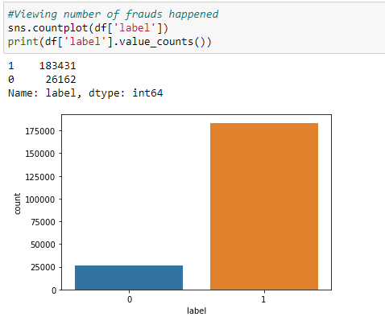
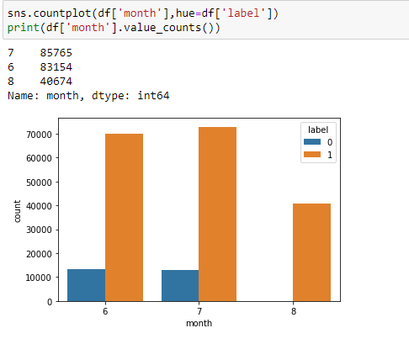
Visualization:
We observed 12.5% of customers not paid the credit amount.
Huge loss to company
Most of the customers not paid in 7th month
Similar count of people not paid in month 6.

Slide 5
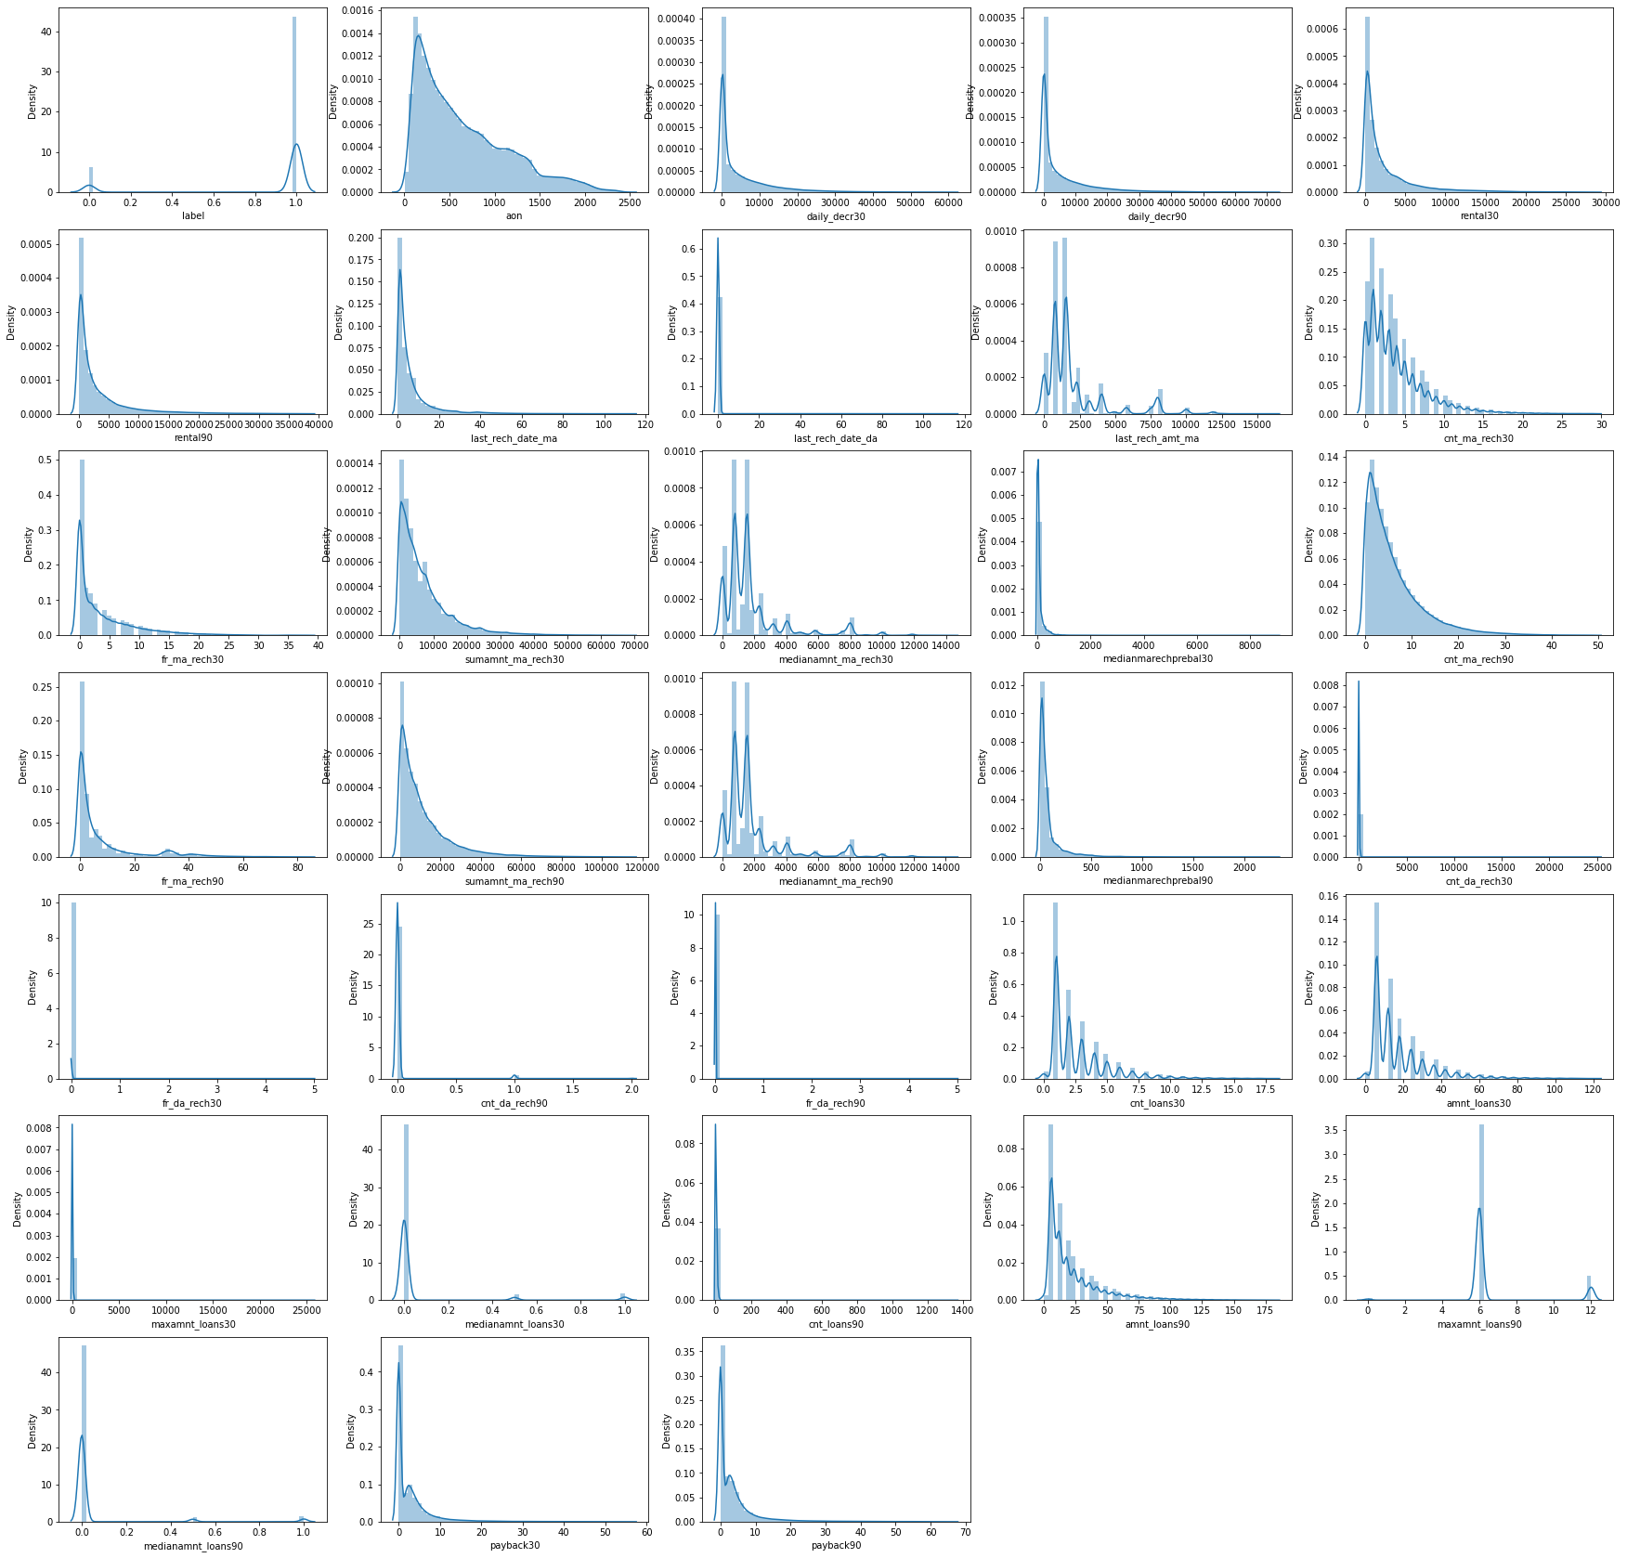
Visualization:
We can see none of the column has
Gaussian distribution
Skewness is present in each and every column

Slide 6
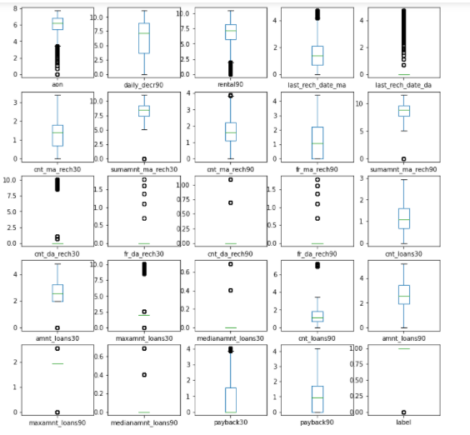
Visualization:
Outliers are removed to reduce skewness,
For a threshold of <6.
Since data loss is more if considered <3
We can see there are lot of outliers
in every
column of the data

Slide 7
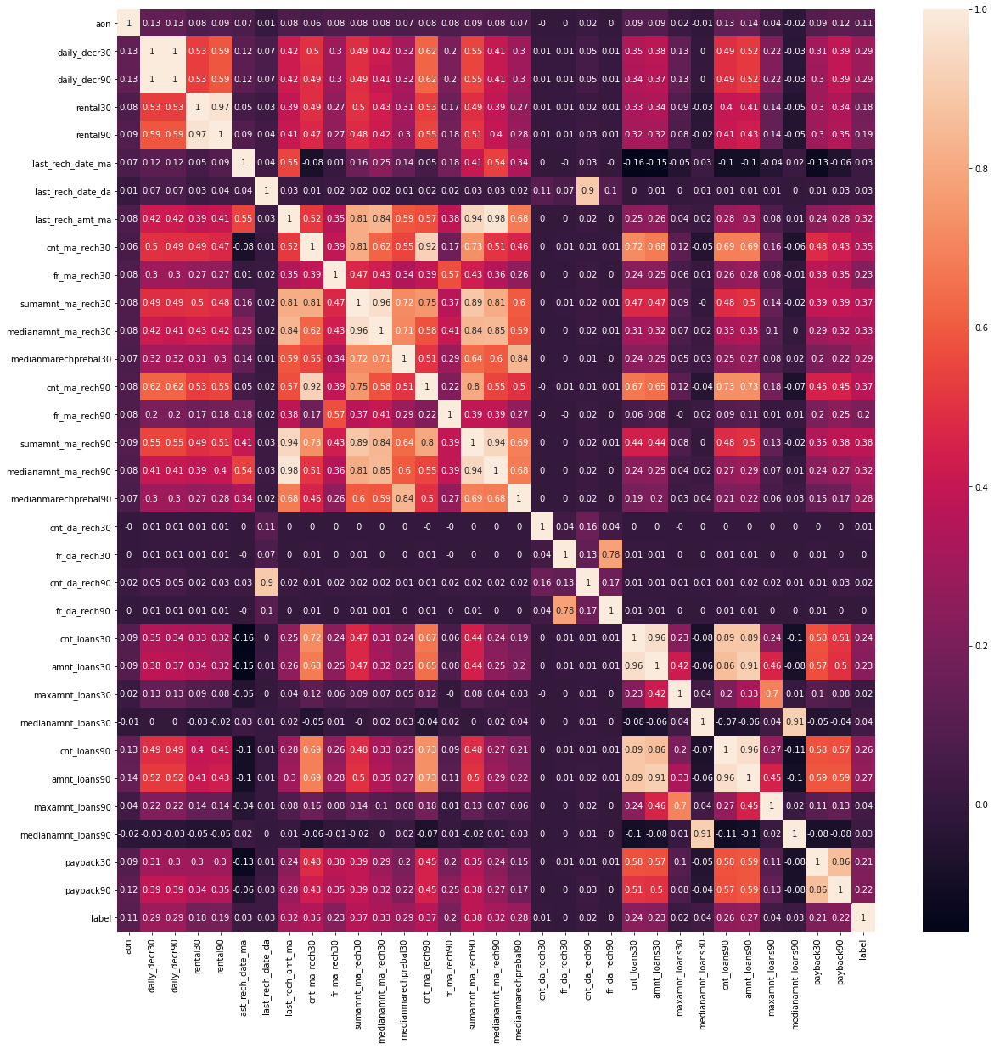
With this heat map we found the correlation
Between columns and with vif values
We dropped few columns
With high multicollinearity.

Slide 8
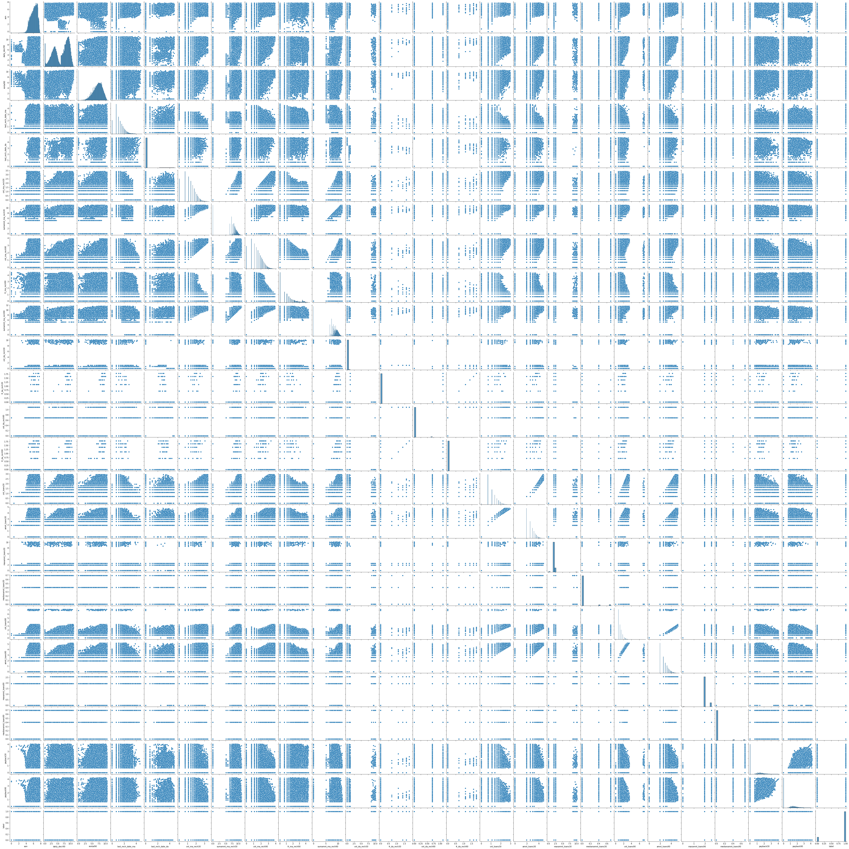
Relation & Behaviour of each column
With respect to other columns.

Slide 9
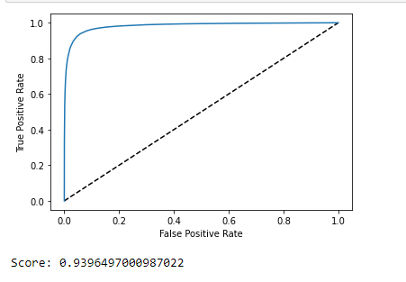
The final model accuracy result plot.
AUC-ROC Curve

Slide 10
Assumptions:
We seen few negative values in some columns, which is not possible,
assumed those might be manual error while entering the data,
and made them positive.
We assumed data with 30 days columns are not required, so we checked
correlation and multicollinearity to drop the columns with 30 than 90 das.
Since it is classification model, and huge data I assumed to use the ensemble
models for better performance and less time to compute.
While making the model, in splitting to train and test stage, I assumed the
random state as 45. (Just an assumption, no supporting reason to select value.)

Slide 11
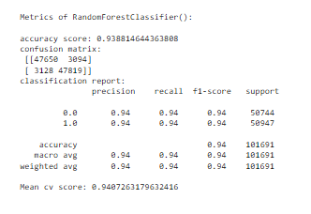
Model:
Since out of all the models we tried
Random Forest Classifier algorithm
Gave the least difference between
Mean cv score and f1 score with less FP
So I considered this as the best model.

Slide 12

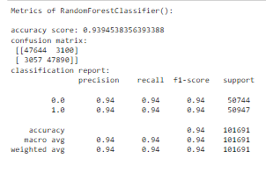
Model:
3100
3057
Confusion Matrix
Model and it’s Metrics
AUC – ROC curve

